Slide 1


Python For DA
Team Name : Data-Driven team

Slide 2








Mahmoud Ayman Abo Naga
Rawan Abdelaleem Eldoador
Zeinab Talaat Antar
Team Roles & Responsibilities
👨‍💻 Data Analyst
🎨 Visualization & Reporting Lead
📊 Business Analyst
Creating clear and informative visualizations
Designing dashboard-style outputs
Assisting in preparing final presentation and reports
Identifying relevant business questions
Interpreting insights from data
Connecting results to real-world decisions
Data cleaning and preprocessing
Extracting KPIs and generating statistical summaries
Ensuring data accuracy and consistency

Slide 3

Code Project link:
ttps://github.com/Abo-Elnaga/smartphone_sales_analysis.ipynb

Slide 4
🔵 3. Insights & Results
Calculated total revenue and profit.
Counted units sold per brand.
Computed average price per brand.
Identified top-rated phone.
Compared average ratings by OS.
Sorted most profitable phones.
Found average profit per unit.
Compared Android vs iOS: Revenue, Profit, Units.
Found correlation between RAM and sales.
📊 Smartphone Sales Data Analysis
🟠 1. Data Analysis
Loaded CSV file using pandas.
Previewed data using .head().
Displayed data types and column info.
Checked for missing values.
🟢 2. Data Cleaning
Standardized text columns (lowercase, no spaces).
Removed missing rows.
Filtered ratings between 1 and 5.
Removed zero/invalid values in numerical columns.
Removed outliers in price using IQR method.
Reset index for cleaned dataset.
🟣 4. Data Visualization
Bar charts for revenue, sales, and profit by brand.
Scatter plots: RAM vs Sales, Battery vs Sales (colored by price).
Pie chart: Average Rating per OS.
Regression: Price vs Quantity Sold.
Bar comparison: Android vs iOS metrics.

Slide 5
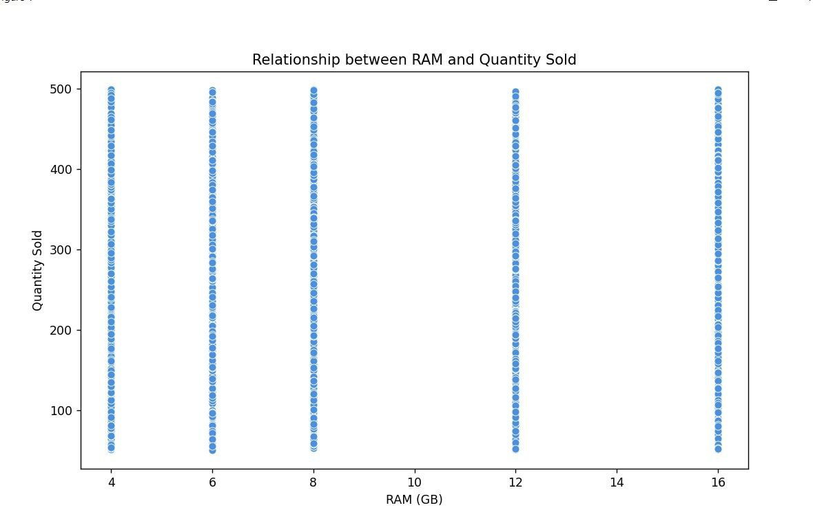
Relationship between Ram & Quantity_sold
This analysis explores how the amount of RAM in a device correlates with the number of units sold, helping to identify whether higher RAM influences purchasing decisions

Slide 6
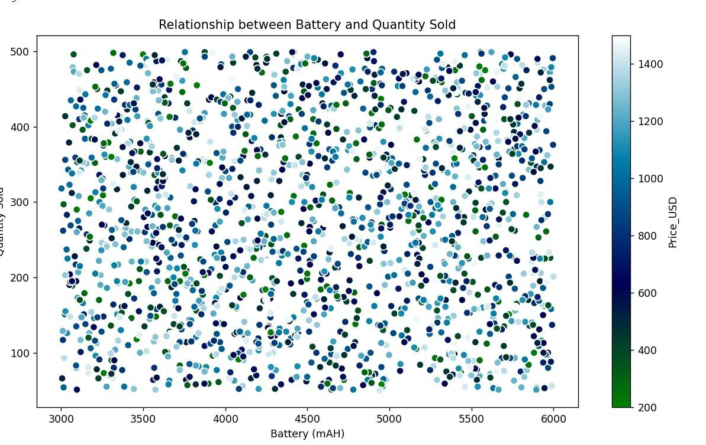
Relationship between Battery and Quantity Sold
Analyzes how battery capacity influences the number of units sold, indicating if consumers prefer devices with longer battery life

Slide 7
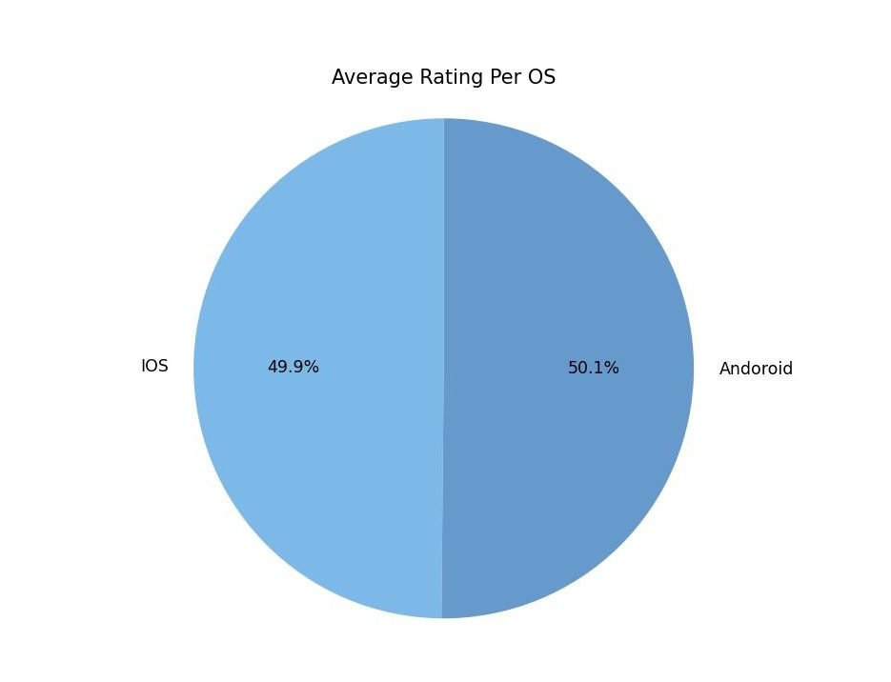
Average Rating Per OS
This metric represents the average user rating for each operating system, helping to compare user satisfaction between Android and iOS

Slide 8
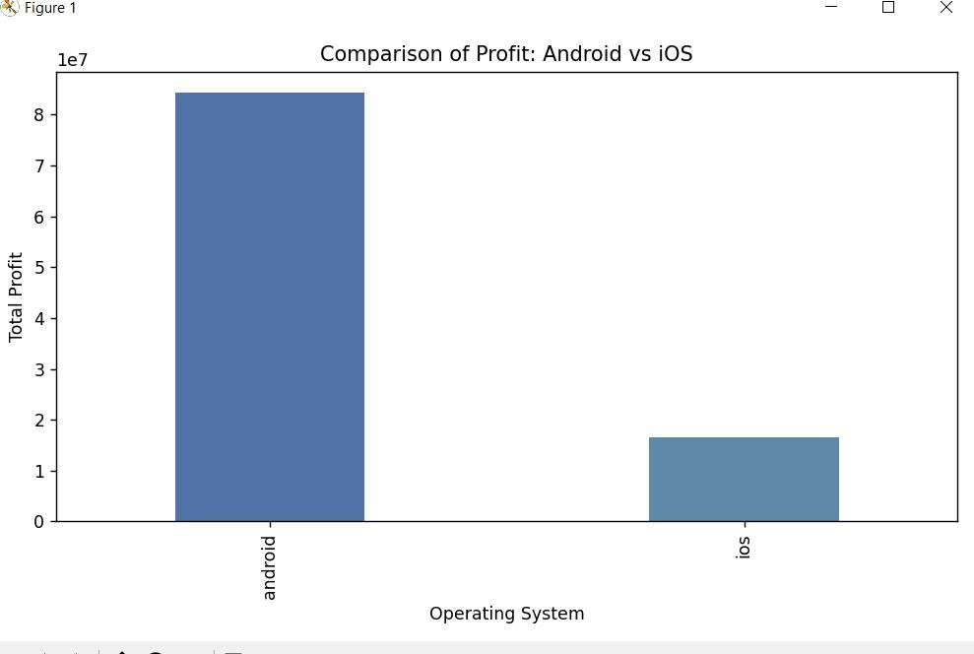
Comparison of Profit: Android vs iOS
This Slide highlights the difference in generated profits between Android and iOS platforms, providing insight into which system yields higher financial returns

Slide 9
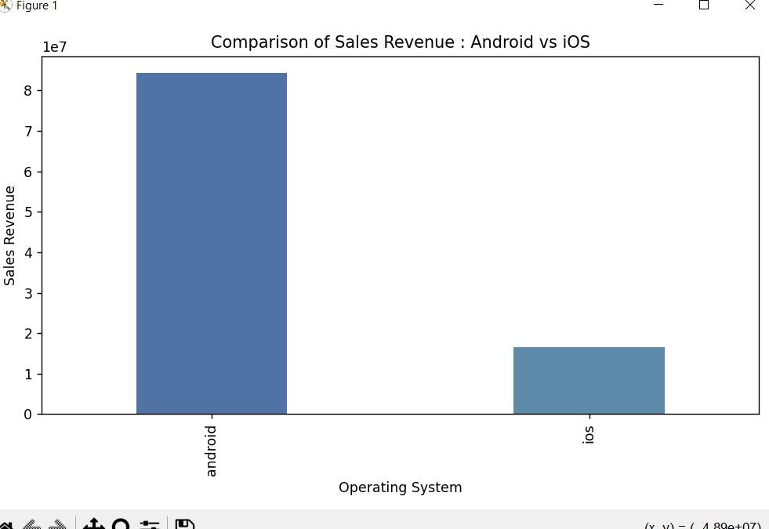
Comparison of sales Revenue: Android vs iOS
This Slide compares the total sales revenue generated by Android and iOS devices, providing insights into which platform generates more income

Slide 10
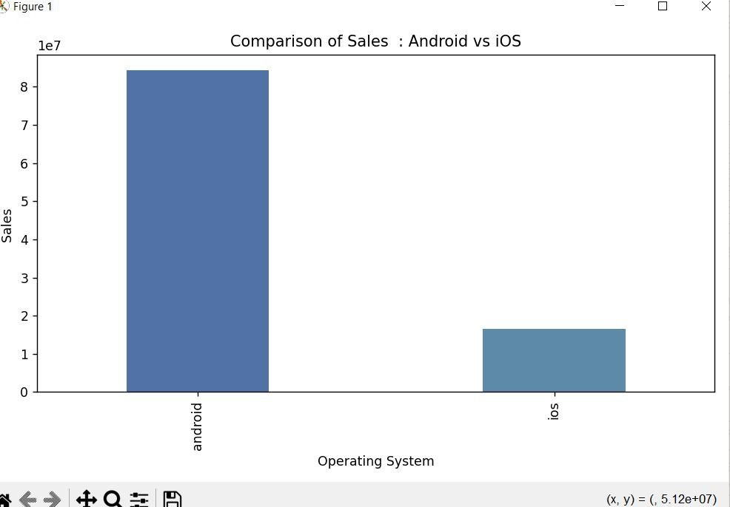
Comparison of Sales
This Slide highlights the overall number of units sold for both Android and iOS devices, offering a clear view of their market performance

Slide 11
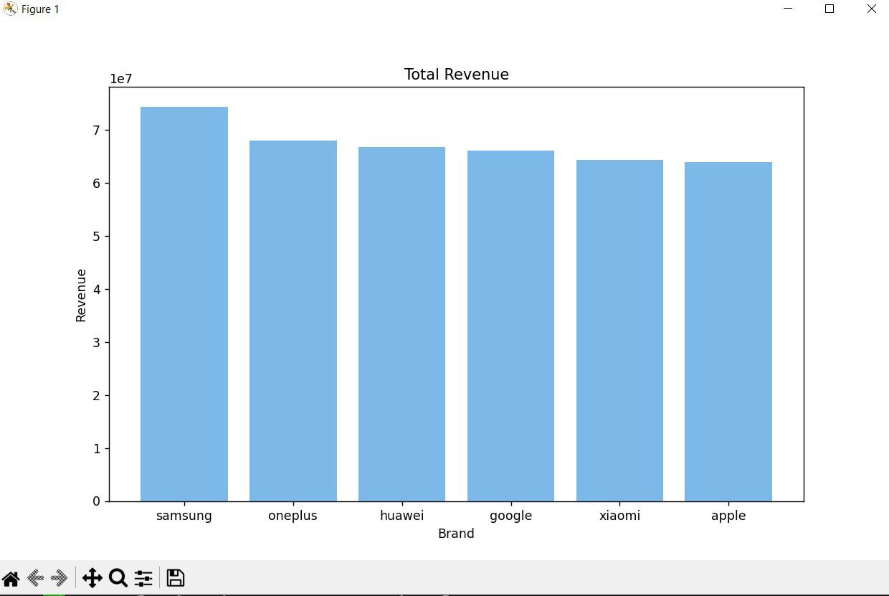
Total Revenue
Shows the complete revenue generated from all device sales across platforms, reflecting overall market earnings

Slide 12
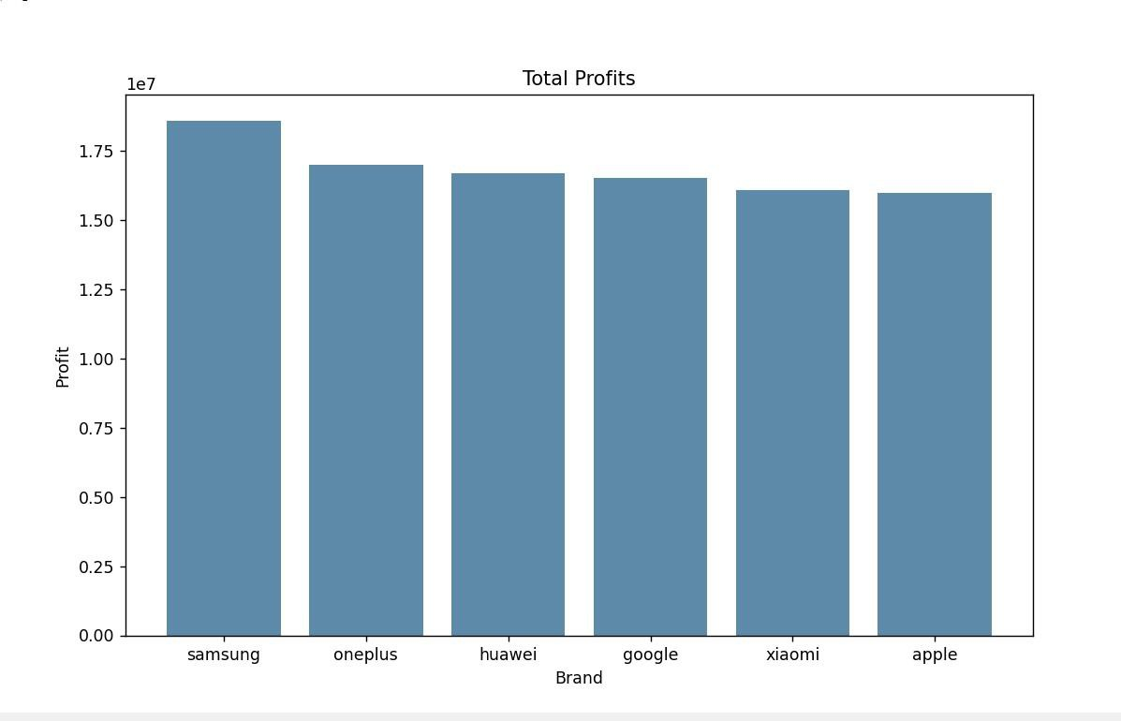
Total Profits
Represents the net profits after expenses, offering a view of the actual financial gain from all device sales

Slide 13
✅ Quick Summary:
Clean and well-prepared data.
Android leads in unit sales, iOS often more profitable.
RAM, battery, and price are key factors in influencing sales.
Thank you

